Slide 1
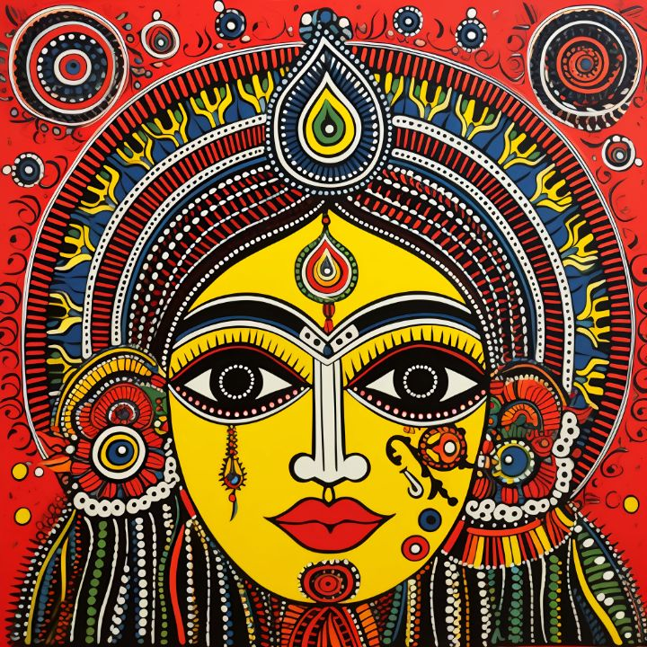
GENERATING NEW MADHUBANI DESIGNS WITH GANS
A Deep Learning Approach to preserving traditional Art.
Presented by-
Abhishek Raj
M.Tech
VIT VELLORE

Slide 2
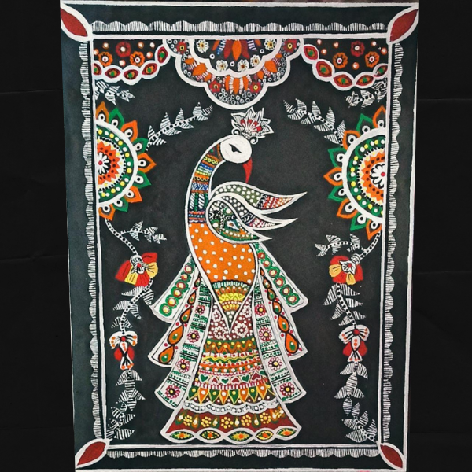
Introduction to Madhubani Art
Overview:
Originated in the Mithila region of Bihar, India.
Traditionally created by women on walls and floors using natural dyes.
Depicts themes from nature, mythology, and daily life.
Styles:
Bharni, Kachni, Godna, Kohbar, and Tantrik.
Cultural Significance:
Represents the rich heritage and traditions of the region.

Slide 3
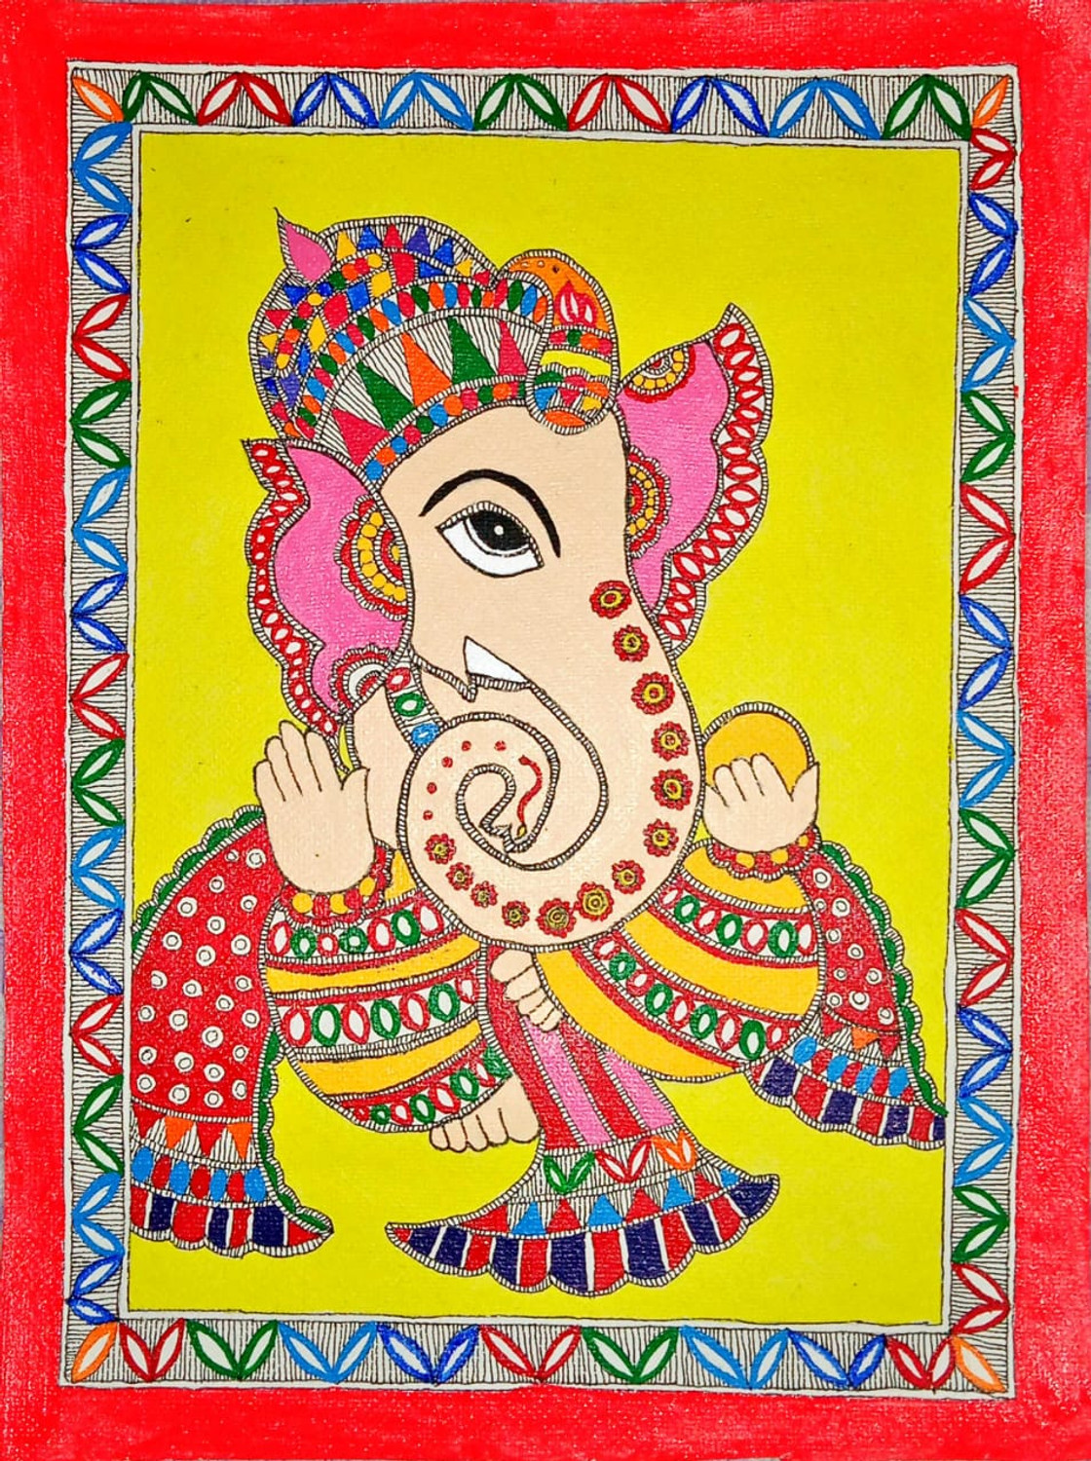
Project Objective
Goal: To develop a Generative Adversarial Network(GAN) that can generate new, authentic looking Madhubani style paintings.
Motivation:
Preserve and promote traditional art forms using modern technology.
Provide tools for artists and designers to explore new designs inspired by Madhubani art.

Slide 4
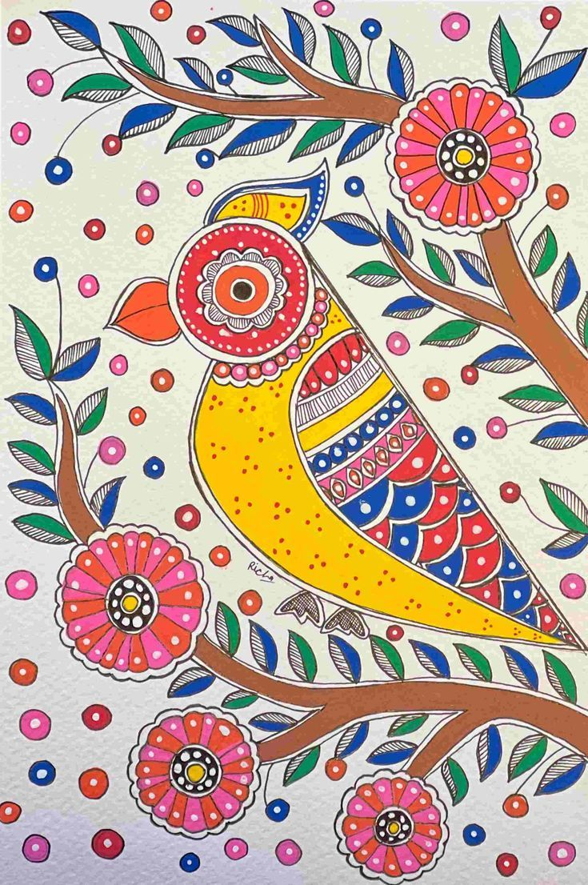
Dataset Preparation
Source: Images collected from kaggle(Indian paintings dataset).
Preprocessing:
Resized images to 64x64 pixels.
Normalized pixel values to [-1, 1].
Filtered out non-Madhubani images.
Challenges:
Ensuring diversity in styles and themes.
Maintaining image quality after preprocessing

Slide 5
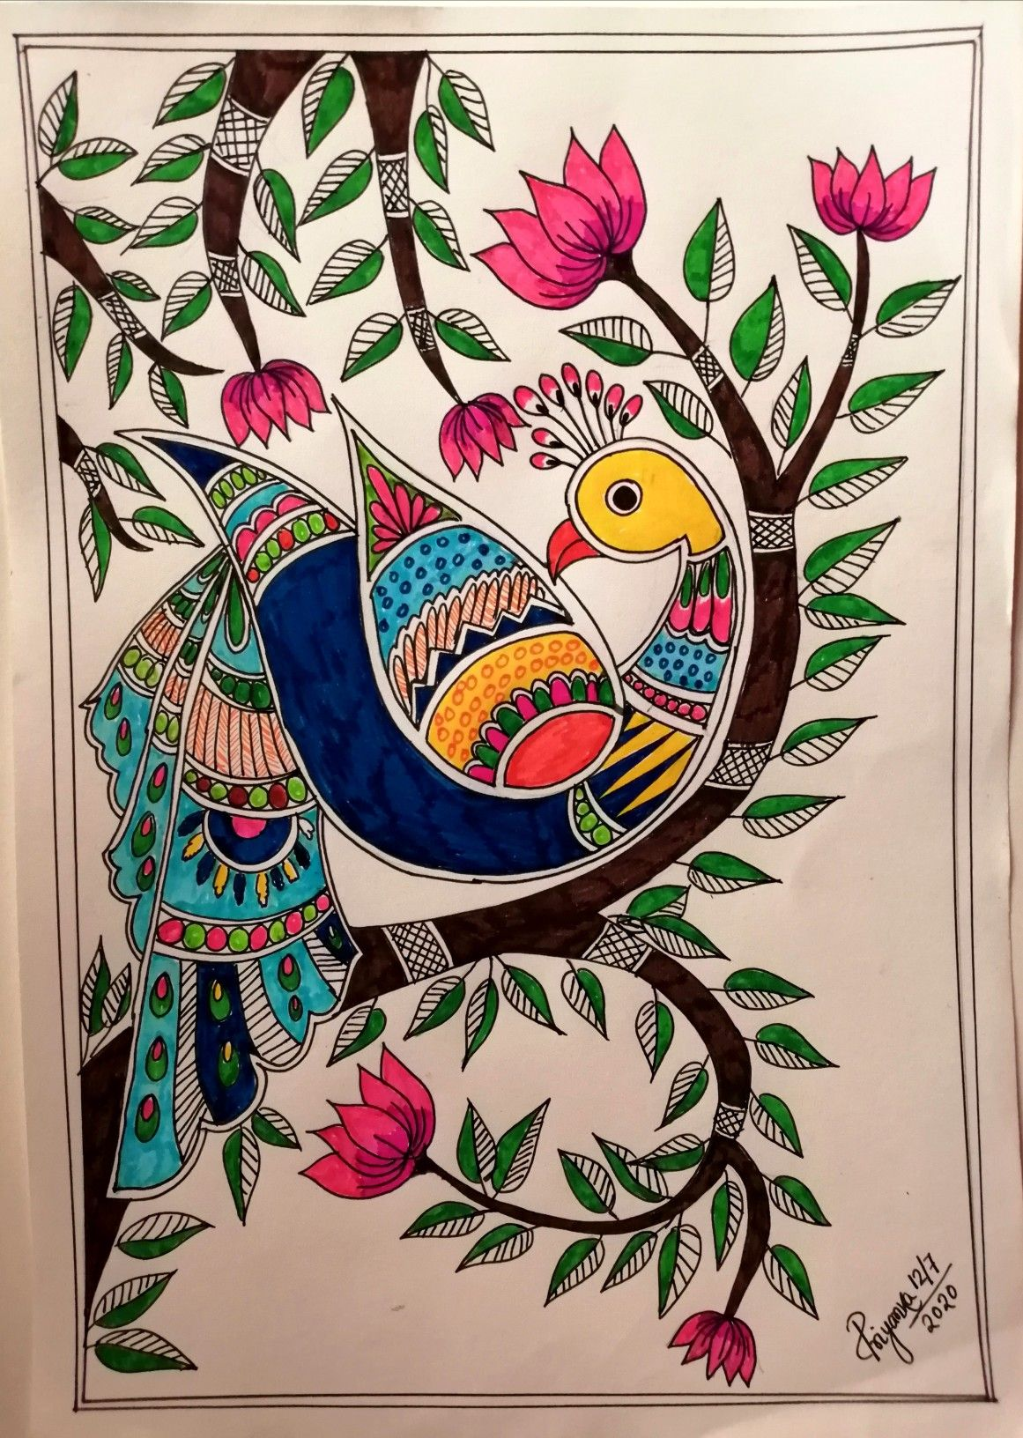
UNDERSTANDING GANs
Components:
Generator: Creates new images from random noise.
Discriminator: Evaluates images as real or fake.
Training Process:
Generator tries to fool the discriminator.
Discriminator learns to distinguish real from generated images.
Both networks improve through adversarial training.

Slide 6
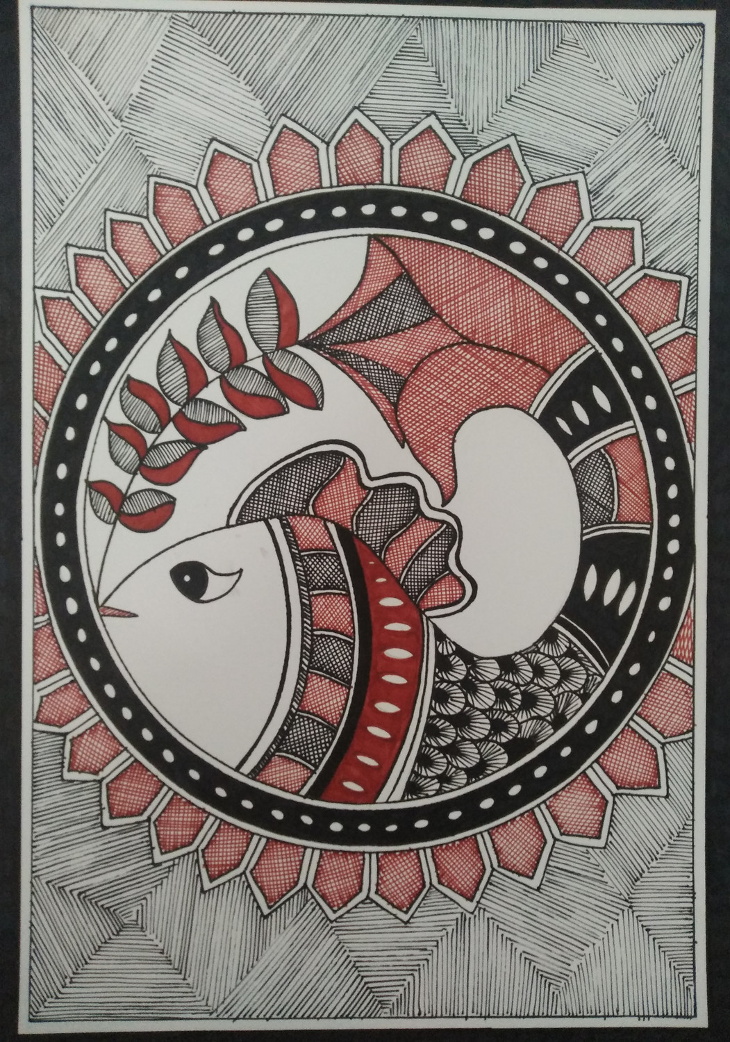
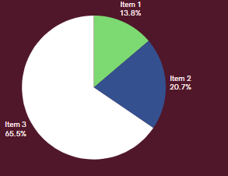
Artstyles Comparison
Artsyles in Generated Madhubani
Distribution of elements in Madhubani pieces.

Slide 7
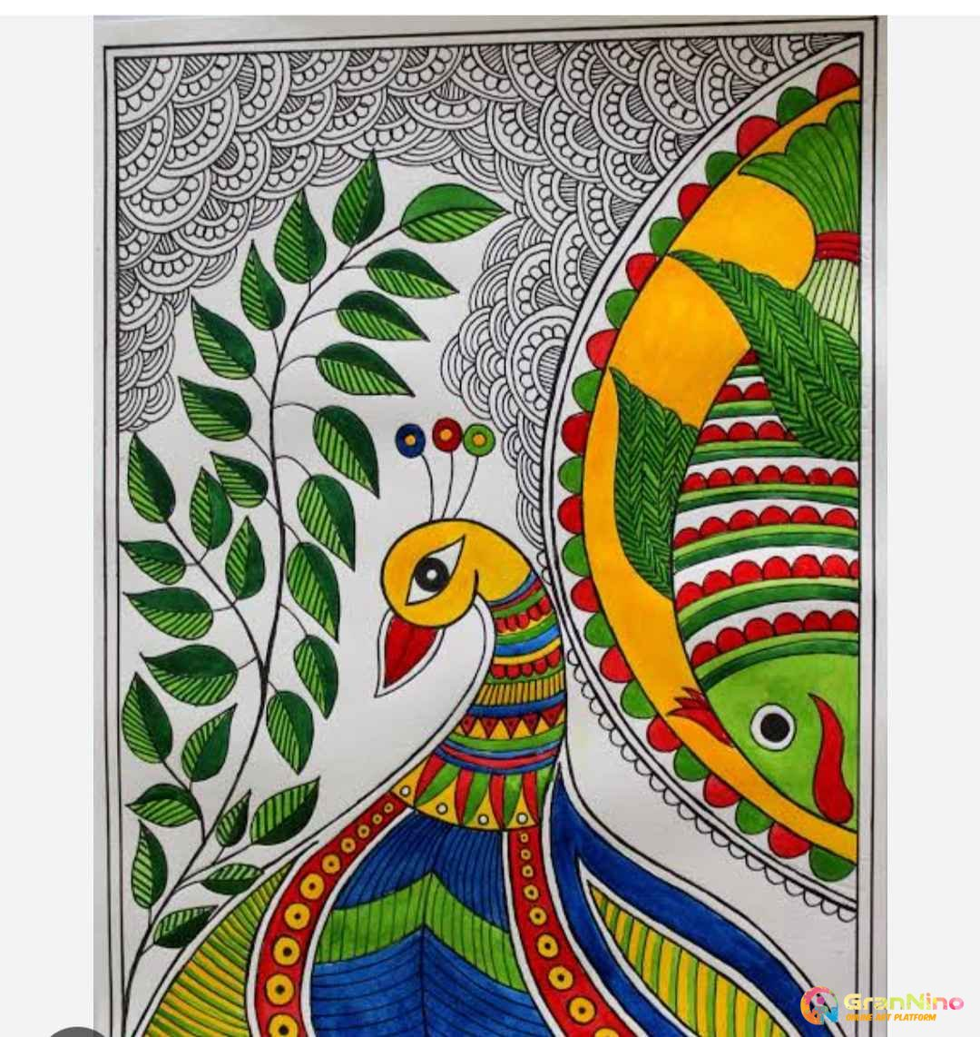
Model Architecture
Generator:
Input: 100-dimensional noise vector.
Layers: Dense → BatchNorm → LeakyReLU → Transposed Convolutions.
Output: 64x64x3 image.
Discriminator:
Input: 64x64x3 image.
Layers: Convolutions → LeakyReLU → Dropout → Dense.
Output: Probability of image being real

Slide 8
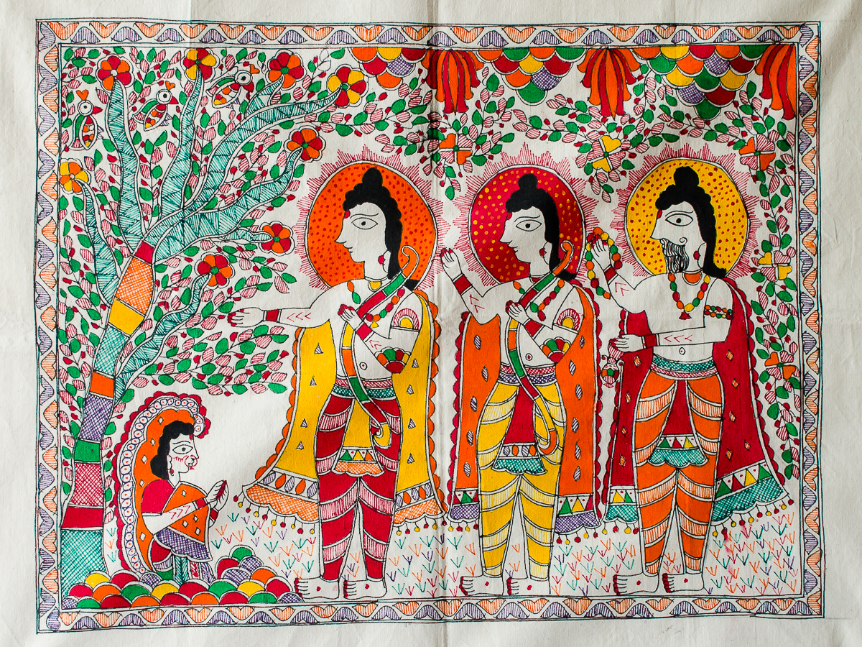
Training Process
Parameters:
Epochs: [Specify Number].
Batch Size: 128.
Optimizer: Adam with learning rate 0.0002.
Loss Functions:
Binary Crossentropy for both generator and discriminator.
Training Loop:
For each epoch:
Train discriminator on real and generated images.
Train generator to produce images that fool the discriminator.

Slide 9
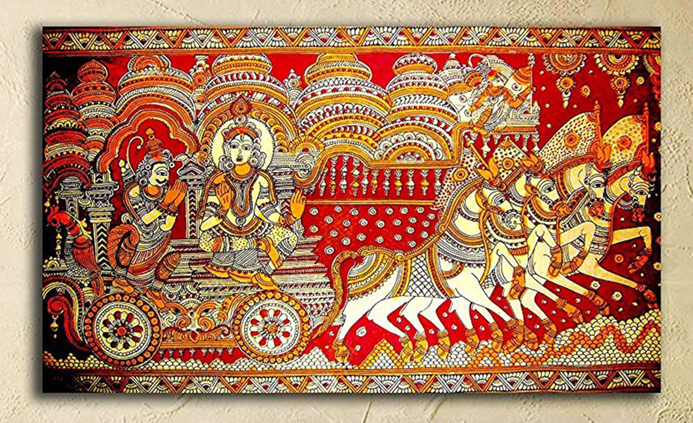
RESULTS
Generated Images:
Showcase a selection of images produced by the generator after training.
Observations:
The generated images exhibit characteristics of traditional Madhubani art.
Variations in styles and motifs are present.
Evaluation:
Visual inspection suggests authenticity.
Potential for quantitative evaluation using metrics like FID in future work.

Slide 10
CHALLENGES AND FUTURE WORK
Challenges:
Limited dataset size may affect diversity.
Capturing intricate details of Madhubani art.
Future Enhancements:
Incorporate style-specific conditioning to generate images in a particular style.
Use higher-resolution images for better detail.
Collaborate with artists for qualitative evaluation and feedback.

Slide 11
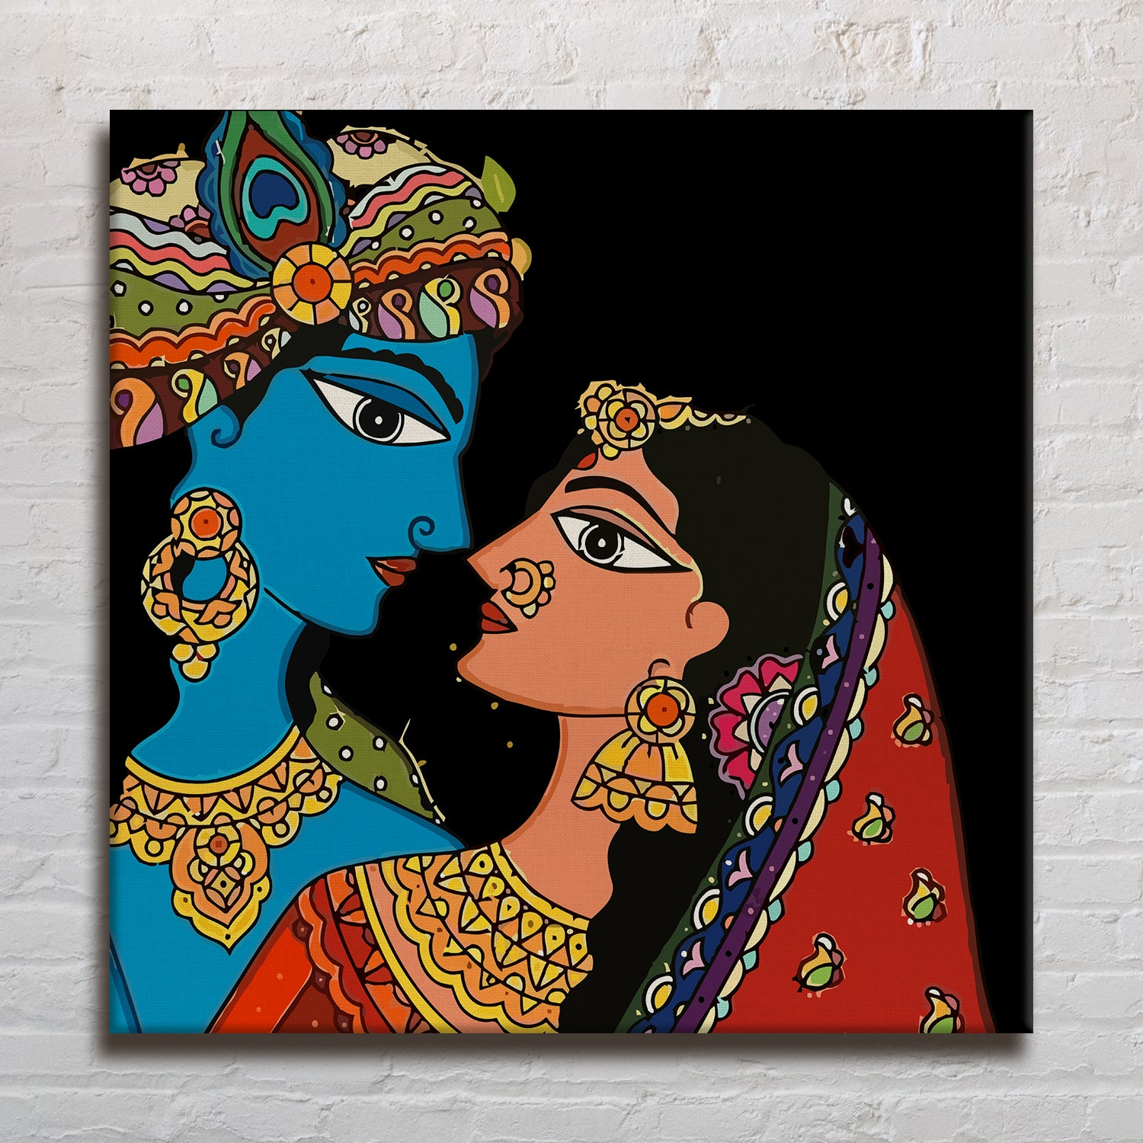
CONCLUSION
Summary:
Successfully implemented a GAN to generate Madhubani-style paintings.
Demonstrated the potential of AI in preserving and promoting traditional art forms.

Slide 12
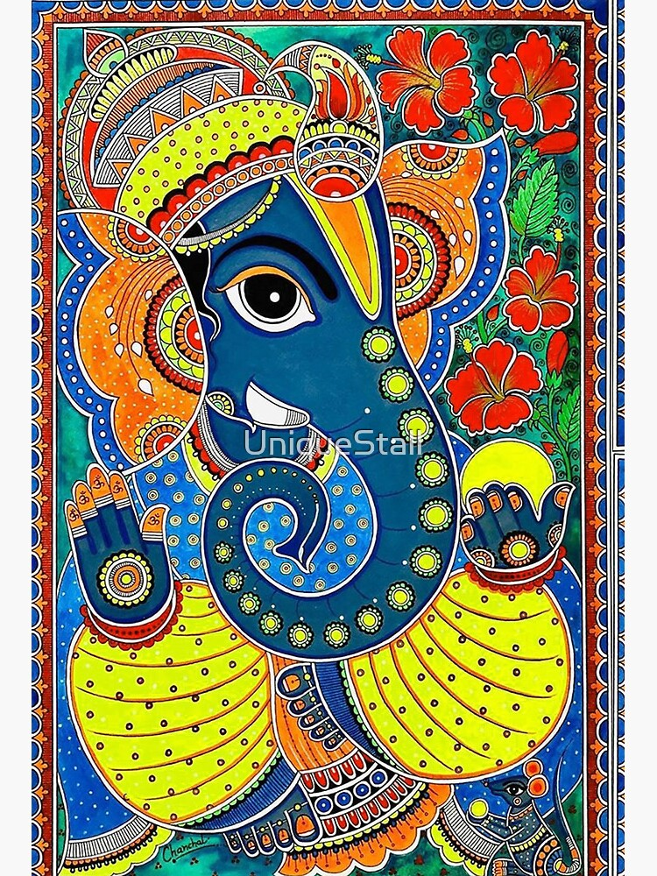
REFERENCES
Goodfellow, I., Pouget-Abadie, J., Mirza, M., Xu, B., Warde-Farley, D., Ozair, S., Courville, A., & Bengio, Y. (2014). Generative adversarial nets.
Radford, A., Metz, L., & Chintala, S. (2015). Unsupervised representation learning with deep convolutional generative adversarial networks.
Salehi, P., Chalechale, A., & Taghizadeh, M. (2020). Generative adversarial networks (GANs)
Wang, Y., & Yamasaki, T. (2022). Generative adversarial networks. arXiv preprint arXiv:2203.00667

